Slide 1
Alpha Beta and Gamma Decay
For The Linguistic Learner and for the Visual Learner In Each of You!
(notes, and some pics!)

Slide 2
Goals of this PowerPoint
To get us out of the note packet ;-)
To introduce a
significant number
of new vocabulary
terms, peculiar to
nuclear chemistry
To help you visualize alpha, and beta decay … because I can’t find a YouTube video good enough
To allow you to self-pace

Slide 3
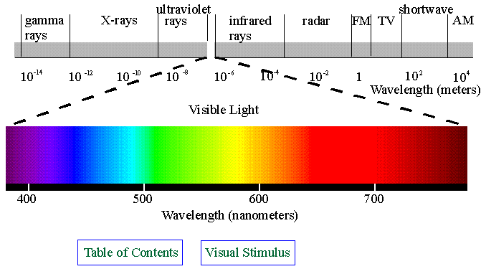
New Vocabulary: Radiation vs. Nuclear Radiation vs. Radioactivity
Radiation is any stream of electromagnetic energy (e.g. light, microwave, radio waves, gamma rays) which travels through space, or some type of medium (e.g. water, air)
Nuclear Radiation refers to any stream of energy (especially gamma) and/or particles released by a nucleus as it breaks apart (decays)

Slide 4
The difference between the two terms, is, the origin of the radiation …
One term, (plain old, radiation) is technically generated by the movement / motion of electrons in the electron cloud of an atom … Those energy shell transitions sourcing what we know as: electromagnetic energy (radiation).. So light is a form of radiation.
Whereas: Nuclear Radiation is generated by the breaking apart of nuclear material (protons and neutrons) in an unstable nucleus. It has nothing to do with electrons!
See? It’s about the origin!!!

Slide 5
Radioactivity
Radioactivity is the PROCESS of emitting energy or particles.
So, radioactivity is the name given to the process of release and nuclear radiation is what is released.
Are We Good On This?

Slide 6
New Vocabulary: Isotope vs. Nuclide vs. Radioisotope
In nuclear chemistry we shall not use the word isotope .. The term isotope is used when stressing the chemical issues of an atom. So toss that term now….
We WILL use the term, nuclide (new-klyd). The term is a broad and generalized term which refers to any nucleus defined by its number of protons (atomic number) and mass number. E.g. C-12 or ${}_{6}^{12}C$ …. A nuclide may be radioactive or stable, in terms of nuclear changes. Isotopes are only one type of nuclide. Even though the term is so broad, it is often used when studying nuclear chemistry. (I hate it … but you will hear the term on videos… )

Slide 7
Isotope vs. Nuclide vs. Radioisotope (continued)
We WILL use the term radioisotope to identify a nucleus (a nuclide) which is radioactive… Often, when, you see or hear the term nuclide, in this unit, it is probably referring to a radioisotope.
Essentially, a radioisotope is a version of a chemical element that has an unstable nucleus and may emit radiation as it decays to a more stable form. Technically a radioisotope is just one type of nuclide, but in this unit they are often used synonymously.
So, C-12 is a nuclide (and yes, it is an isotope of C-14 …) but it is stable in terms of its nucleus, so it is NOT a radioisotope.
C-14 is a nuclide (and it is an isotope of C-12) AND we may call C-14 a radioisotope because as a nucleus it is unstable, and it will, at some point in time, release radiation…

Slide 8
New Vocabulary: Nuclear Transmutation
The term, Nuclear Transmutation refers to the conversion of a nuclide (or radioisotope) of one element into a nuclide of another, completely different element. It’s analogous to the term “chemical reaction” … but it’s all about the nucleus. A transmutation results in a more stable nuclide and in the release of some form of radiation. So, it is reasonable to conclude that a nuclear transmutation involves a change in the number or protons and/or the number of neutrons of a nucleus. And we know, that if you change the number of protons…you change the element!
Alpha decay, Beta decay, Positron decay and Nuclear Fission, and Nuclear Fusion are examples of Nuclear Transmutations.
Note: Gamma decay is not technically considered to be a nuclear transmutation.
That sounds sort of odd …right? How can it be a nuclear change, but not change the element???

Slide 9
Examples of Nuclear Transmutations
${}_{6}^{14}C$→ ${}_{−1}^{0}e$ + ${}_{7}^{14}N$ This is a transmutation because C-14 transmutes to N-14. N-14 is a different element … Something must have happened to the number of protons in C-14. N-14 is called the daughter nuclide.
${}_{86}^{222}{Rn}$→ ${}_{2}^{4}{He}$ + ${}_{84}^{218}{Ra}$ This is a nuclear transmutation too… Notice that radon-222 has turned into He-4 and Ra-218.
Ra-218 is called the daughter nuclide.
${}_{12}^{23}{Mg}\text{→ }{}_{+1}^{0}e\text{ + }{}_{11}^{23}{Na}$ This is a nuclear transmutation, I can tell, because the element on the reactant side, is different from the species on the product side …Na-23 is the daughter nuclide

Slide 10
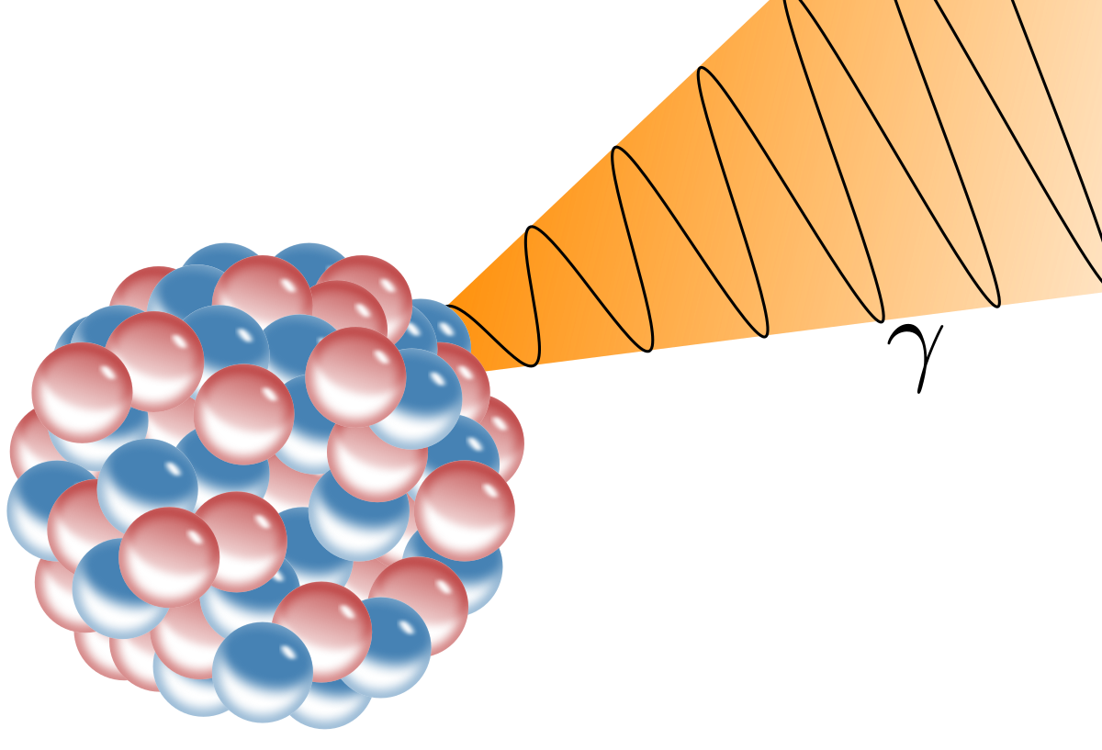
Quickly, What Is A Nuclear Reaction, But Not A Transmutation?
Well, that would be gamma decay … During gamma decay, the number of protons does not change … The protons and neutrons (the nucleons) simply “rearrange” themselves into a more comfortable structure, and a very high frequency energy (a gamma ray) is released!
${}_{53}^{131}I$→ ${}_{53}^{131}I$ + γ This is the symbol for a gamma ray … It is just a blast of high frequency electromagnetic energy
There is no change in the number of protons or
in the number of neutrons …
This Photo by Unknown Author is licensed under CC BY-SA

Slide 11
What is Alpha Decay?
Alpha decay is a natural transmutation. No outside force is required for it to occur. There is only 1 reactant. On the product side, an alpha particle is produced, and a new daughter nuclide is produced. (A daughter nuclide is the term given to the new nuclide)
A radioactive nuclide spits out a number of protons and neutrons equal to a He-4 nucleus. (no electrons are involved …it isn’t a He-4 atom … just a nucleus. So it has a charge of +2 due to the two protons. It has a mass number of 4 due to 2 protons & 2 neutrons….
This type of radioactive nuclide is called an alpha emitter. One of the products of an alpha decay, MUST be an alpha particle.

Slide 12
Summary of Alpha Decay
It’s a natural decay.
No outside force causes it.
There is only 1 reactant, called an alpha emitter
One product MUST BE He-4
The daughter nuclide is smaller than the original reactant, but more stable

Slide 13
Check out the next slide … It is designed to help you grasp what alpha decay is all about … Notice that 2 protons and 2 neutrons are ejected … (He-4) …and the original radioisotope turns into a different nuclide …[It lost protons!!!!] …. You will need to click through the slide … Notice the nucleons are moving around … I am trying to imply an unsettled, unstable nuclide. Once on the next slide, click and analyze what happens … Repeat it, if you wish ….

Slide 14
The color change from blue to red, indicates that the parent nucleus becomes a nucleus (a daughter nucleus) of a different element (with 2 fewer protons & 2 fewer neutrons than the parent nuclei.)
An alpha particle
Key
proton
neutron

Slide 15
What Is Beta Decay?
Well before we discuss that … look at the animation on the next slide. Can you figure out what is happening?
One of the challenges about beta decay, is that it releases a beta particle. No big deal until you realize a beta particle is a high speed electron…(${}_{−1}^{0}e).$But, we’re discussing the nucleus! Where’s the electron coming from?
Uh, Professor, you told me that electrons are outside the nucleus! Well, you actually know the answer, from our earlier work on atomic structure … Hmmm…

Slide 16
Watch this neutron
It turns into a proton as an electron is emitted
Did you recall that a neutron is a proton blended with an electron?
Key
electron: a beta particle
proton
neutron

Slide 17
Summary of Beta Decay
It’s a natural decay.
No outside force causes it.
There is only 1 reactant, called a beta emitter
One product MUST BE an electron (${}_{−1}^{0}e)$
A neutron breaks into a proton and electron. The proton is massive and lacks the kinetic energy to leave. The smaller electron is ejected propelled by some released energy.
The daughter nuclide has the same mass number than the original reactant, but there is now one more proton. So the atomic number is different … thus a transmutation

Slide 18
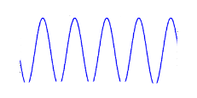
Visualization of Gamma Decay
Simply a release of high frequency energy …very damaging to DNA
Key
proton
neutron

Slide 19
Penetration of Radiation

Slide 20
Ionizing Radiation
Alpha particles, beta particles, and gamma rays are example of ionizing radiation.
Alpha and beta radiation ionize directly whereas gamma rays are believed to be more of an indirect influencer of ionization.
Essentially these forms of radiation can attack / break / alter the chemical bonds of molecules making up biological tissue. They can knock electrons out … oxidize … ionize molecules … Cells can repair themselves but exposure to radiation may cause damage which gets repaired incorrectly, leading to mutations or cancers

Slide 21
Alpha particles can’t penetrate paper, or clothing…per the picture on slide 19. However, were you to breath in an alpha emitter, like Ra-222, which is a gas, the alpha particles emitted can ionize atoms … knock off electrons (oxidize atoms) … causing lung cancer
Beta struggle getting through skin … but were you to ingest or breath in a beta emitter, the released electrons can also ionize molecules making up biological tissues … This is why in the movies everyone is being scrubbed down, after radiation exposure (Think: Dr. No … a James Bond film)
Gamma rays can pass through our body … Heck they can go through concrete! They are like high energy x-rays … they fragment molecules … and these waste products go on to ionize tissue. So, gamma rays are a bit more indirect in their activity… Think: The Hulk.. although that story is purely fiction…

Slide 22
Okay! Those are the basics ideas I wish you to know about Natural Radioactivity… There is more to know … and for that we must get back to the notes …

